Slide 1
The Evolution of Multimodal Learning
From ALBEF to BLIP-2

Slide 2
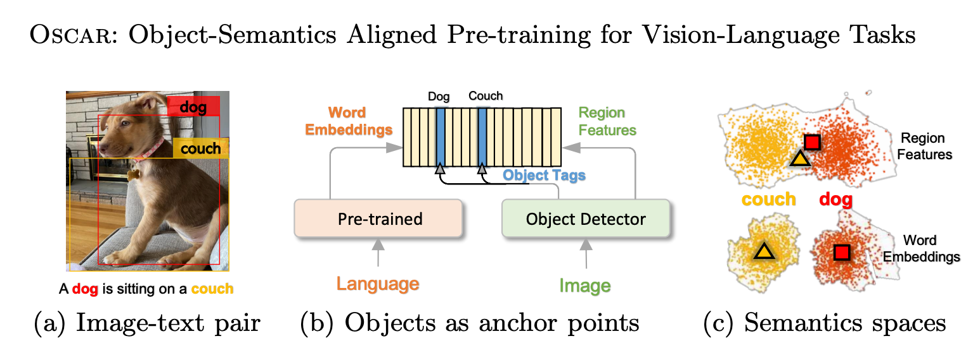
ALBEF-Motivation
The model performance is limited due to the detector
The image features and the word token embeddings reside in their own spaces
Align before Fuse: Vision and Language Representation Learning with Momentum Distillation [NeurIPS2021]
Oscar: Object-Semantics Aligned Pre-training for Vision-Language Tasks [ECCV2020]

Slide 3
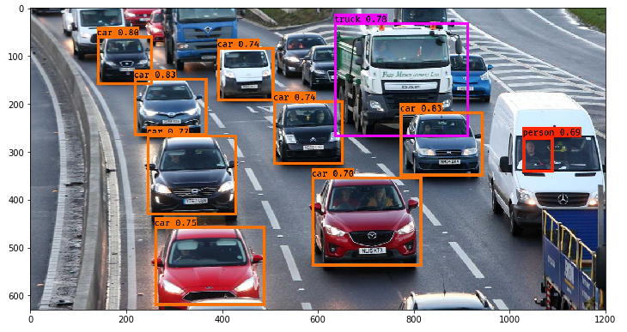
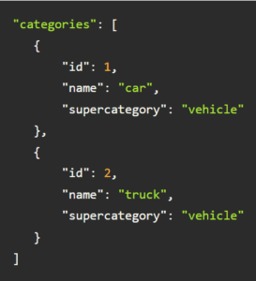
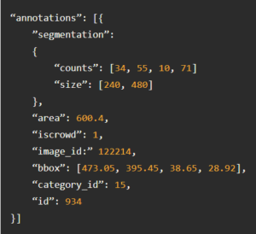
Background Knowledge
COCO Dataset

Slide 4
ALBEF-Motivation
The model performance is limited due to the detector
The image features and the word token embeddings reside in their own spaces
Align before Fuse: Vision and Language Representation Learning with Momentum Distillation [NeurIPS2021]
Oscar: Object-Semantics Aligned Pre-training for Vision-Language Tasks [ECCV2020]

Slide 5
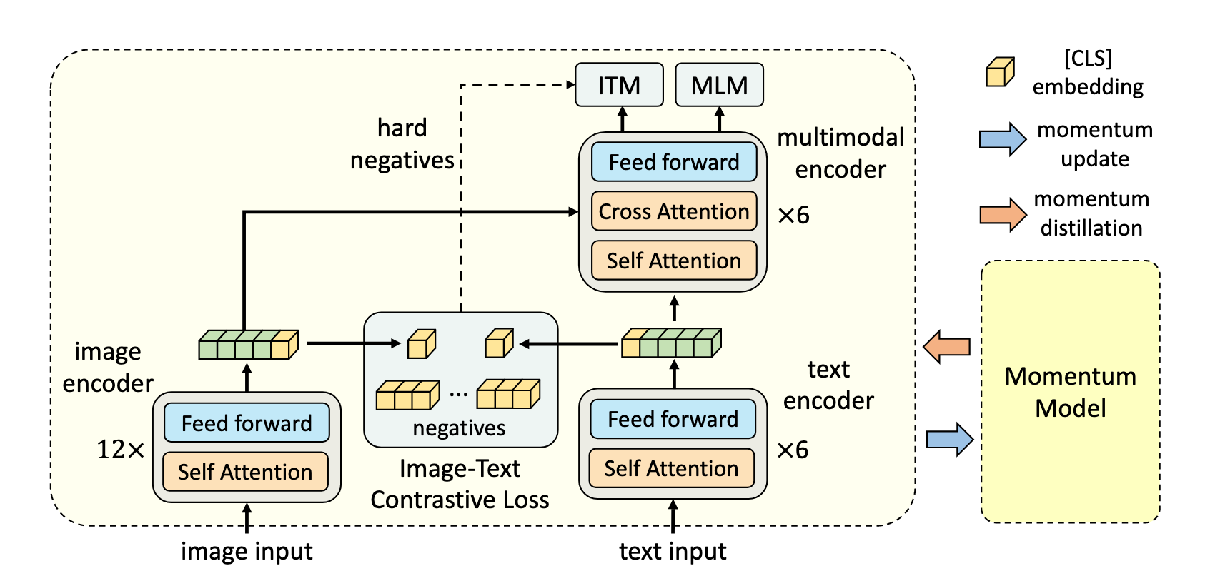
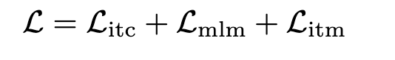
ALBEF-Method
Image Encoder:
12 layers ViT-B/16
Text Encoder:
The first 6 layers of BERT
Multimodal encoder:
The last 6 layers of BERT
Align before Fuse: Vision and Language Representation Learning with Momentum Distillation [NeurIPS2021]

Slide 6
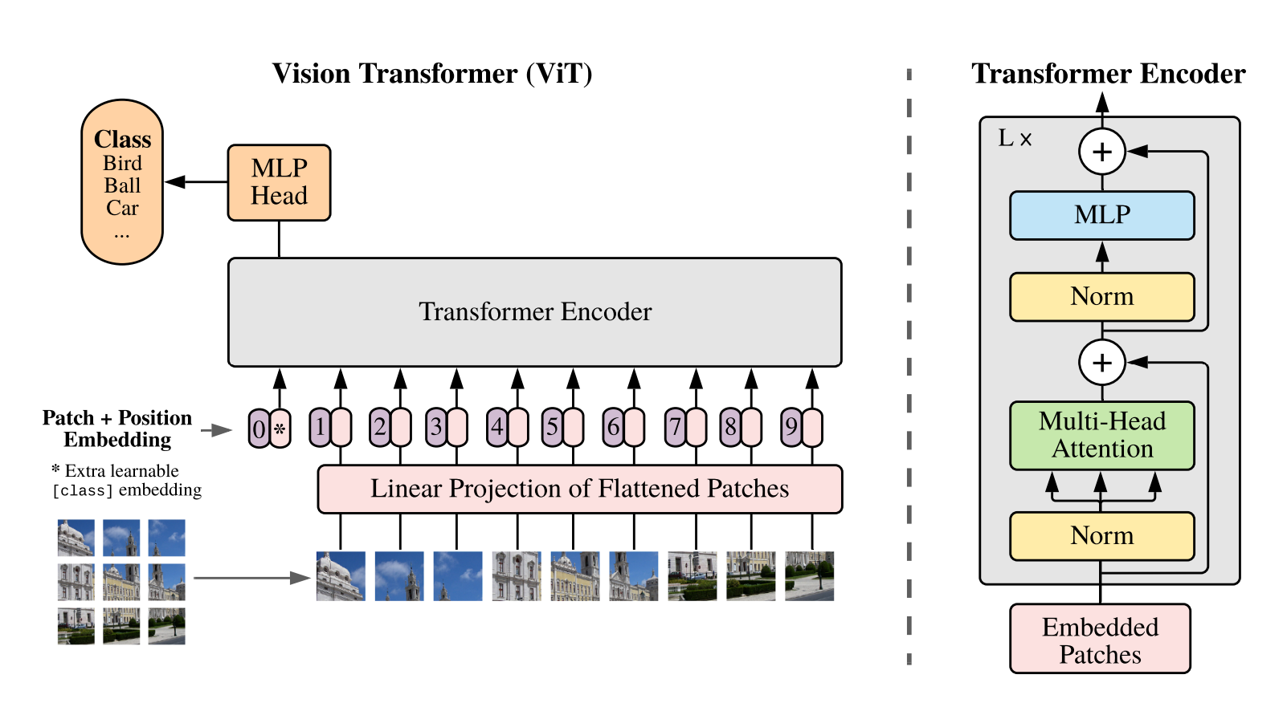
Background Knowledge
CLS token
AN IMAGE IS WORTH 16X16 WORDS: TRANSFORMERS FOR IMAGE RECOGNITION AT SCALE

Slide 7
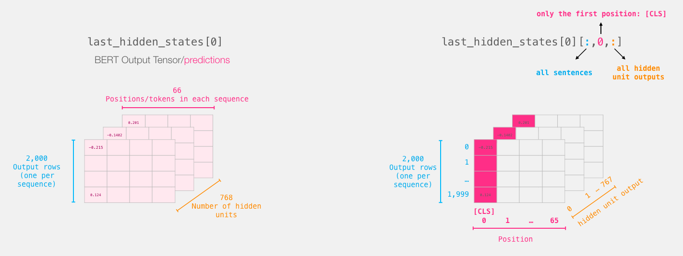
Background Knowledge
CLS token
BERT is bidirectional, the [CLS] is encoded including all representative information of all tokens through the multi-layer encoding procedure. The representation of [CLS] is individual in different sentences.

Slide 8
ALBEF-Method
Image Encoder:
12 layers ViT-B/16
Text Encoder:
The first 6 layers of BERT
Multimodal encoder:
The last 6 layers of BERT
Align before Fuse: Vision and Language Representation Learning with Momentum Distillation [NeurIPS2021]

Slide 9
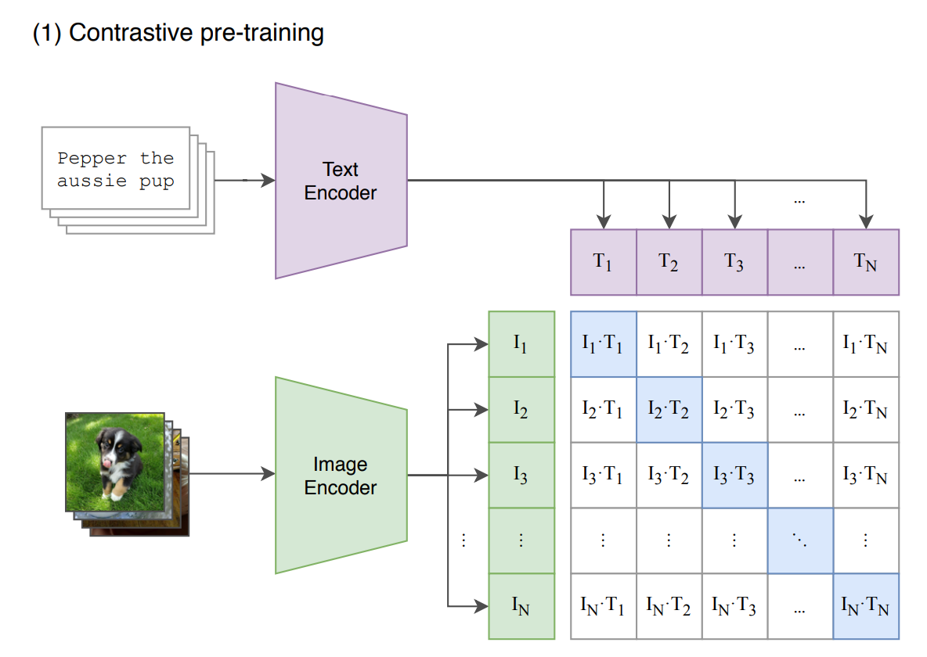
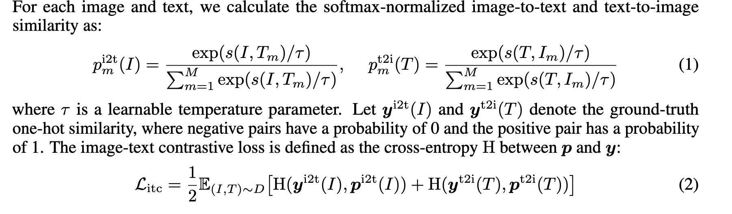
ITC (Image-Text Contrastive) Loss
Learning Transferable Visual Models From Natural Language Supervision

Slide 10
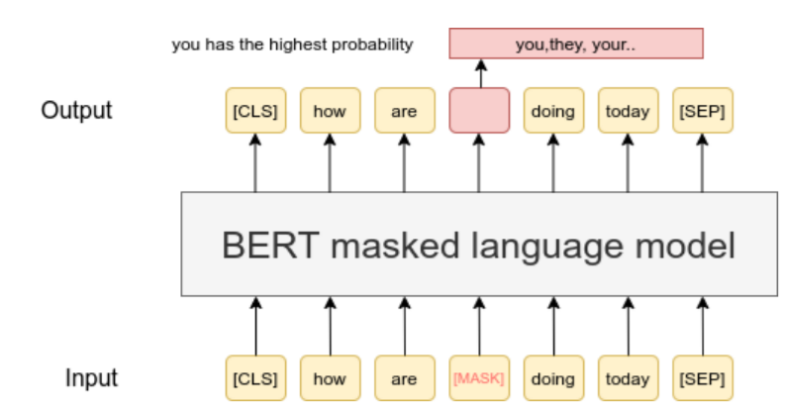
MLM (Masked Language Modeling) Loss

Slide 11
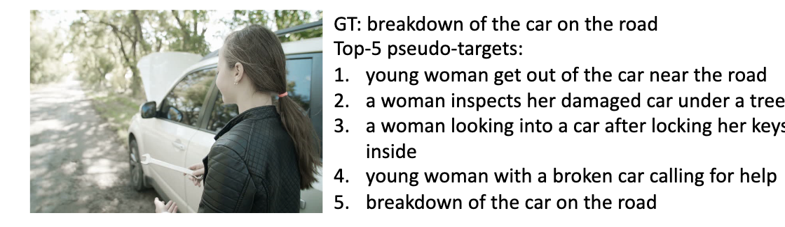
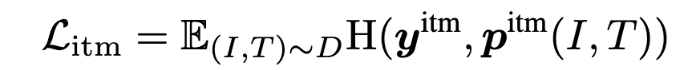
ITM (Image-Text Matching) Loss
Hard Negative Samples
share similar semantics but differ in details

Slide 12
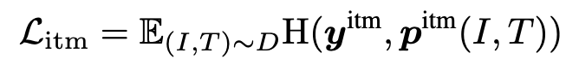
ITC (Image-Text Contrastive) Loss
VS.
ITM (Image-Text Matching) Loss
Similarities: Both ITM and ITC losses aim to distinguish between matched (positive) and unmatched (negative) image-text pairs.
This loss focuses on aligning the embeddings of image and text pairs in a shared embedding space. It uses a contrastive learning approach to bring the embeddings of positive pairs closer together and push the embeddings of negative pairs apart.
This loss uses a classification approach. It takes the joint representation of the image-text and predicts whether the pair is a match or not.

Slide 13
ALBEF-Method
Image Encoder:
12 layers ViT-B/16
Text Encoder:
The first 6 layers of BERT
Multimodal encoder:
The last 6 layers of BERT
Align before Fuse: Vision and Language Representation Learning with Momentum Distillation [NeurIPS2021]

Slide 14
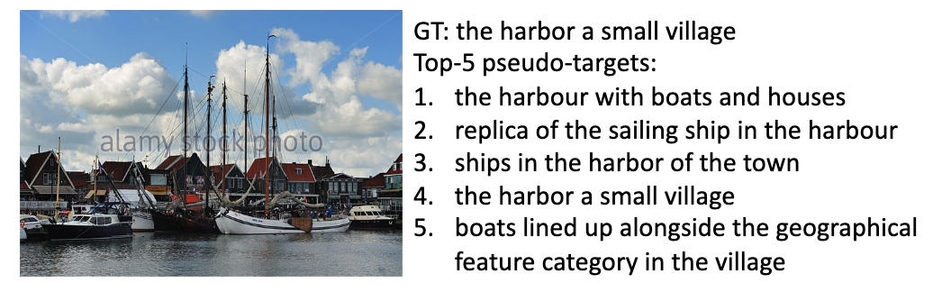
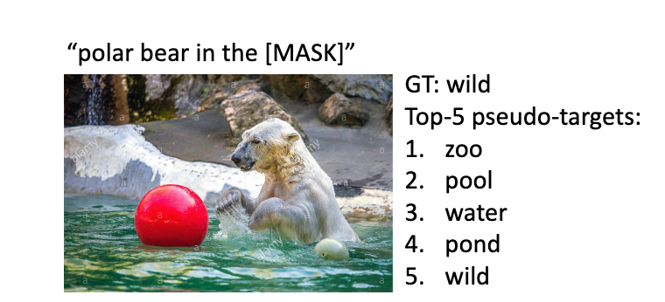
Momentum Distillation
is a technique used to improve the training of models by addressing the issue of noisy data in image-text pairs.
Problem with Noisy Data:
Weakly-Correlated Pairs: The text might contain unrelated words, or the image might have elements not described in the text.
Image Text Contrastive (ITC) Issues: sometimes negative text samples may still relate to the image content
Masked Language Modeling (MLM) Issues: different words might describe the image equally well
Align before Fuse: Vision and Language Representation Learning with Momentum Distillation [NeurIPS2021]

Slide 15
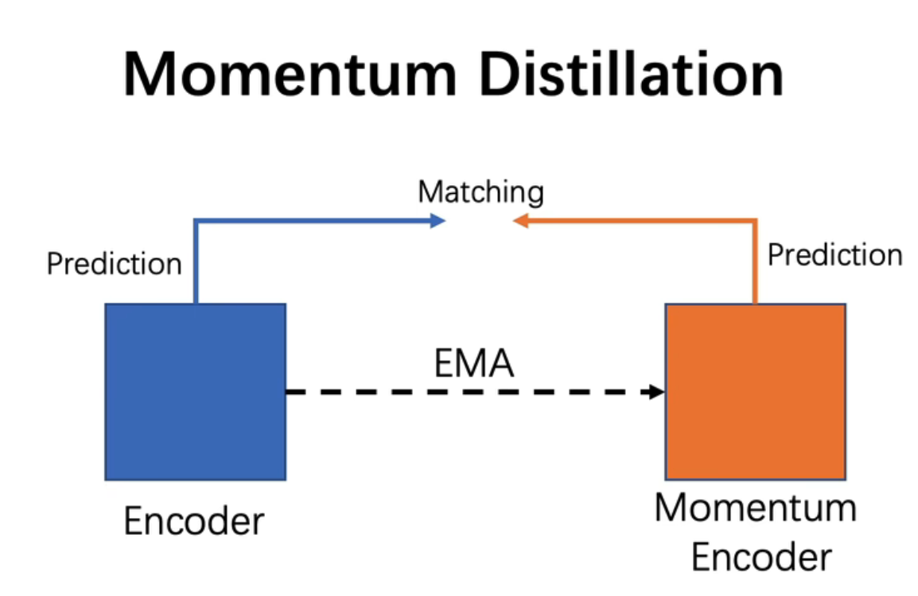
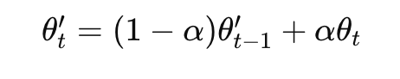
Momentum Distillation
EMA (exponential-moving-average ):
Solutions of Noisy Data:
Momentum Model: an exponential-moving-average version of the model being trained
Pseudo-Targets: use the predictions from the momentum
Align before Fuse: Vision and Language Representation Learning with Momentum Distillation [NeurIPS2021]

Slide 16
BLIP-Motivation
Model perspective:
Encoder-based model ❌ generation tasks
Encoder-decoder-based model ❌ retrieval tasks
Data perspective:
The web data contains noise
BLIP: Bootstrapping Language-Image Pre-training for Unified Vision-Language Understanding and Generation

Slide 17
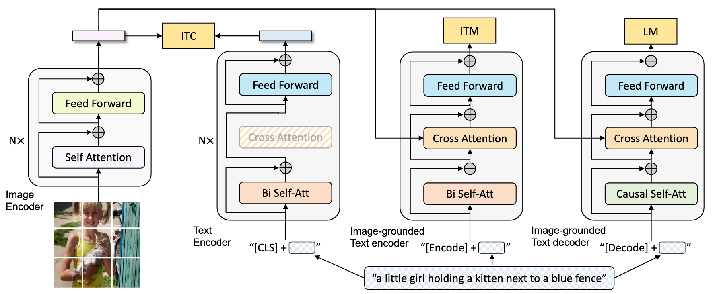
BLIP-Method
Multimodal mixture of Encoder-Decoder (MED)
BLIP: Bootstrapping Language-Image Pre-training for Unified Vision-Language Understanding and Generation

Slide 18
BLIP-Method
BLIP
ALBEF
BLIP: Bootstrapping Language-Image Pre-training for Unified Vision-Language Understanding and Generation

Slide 19
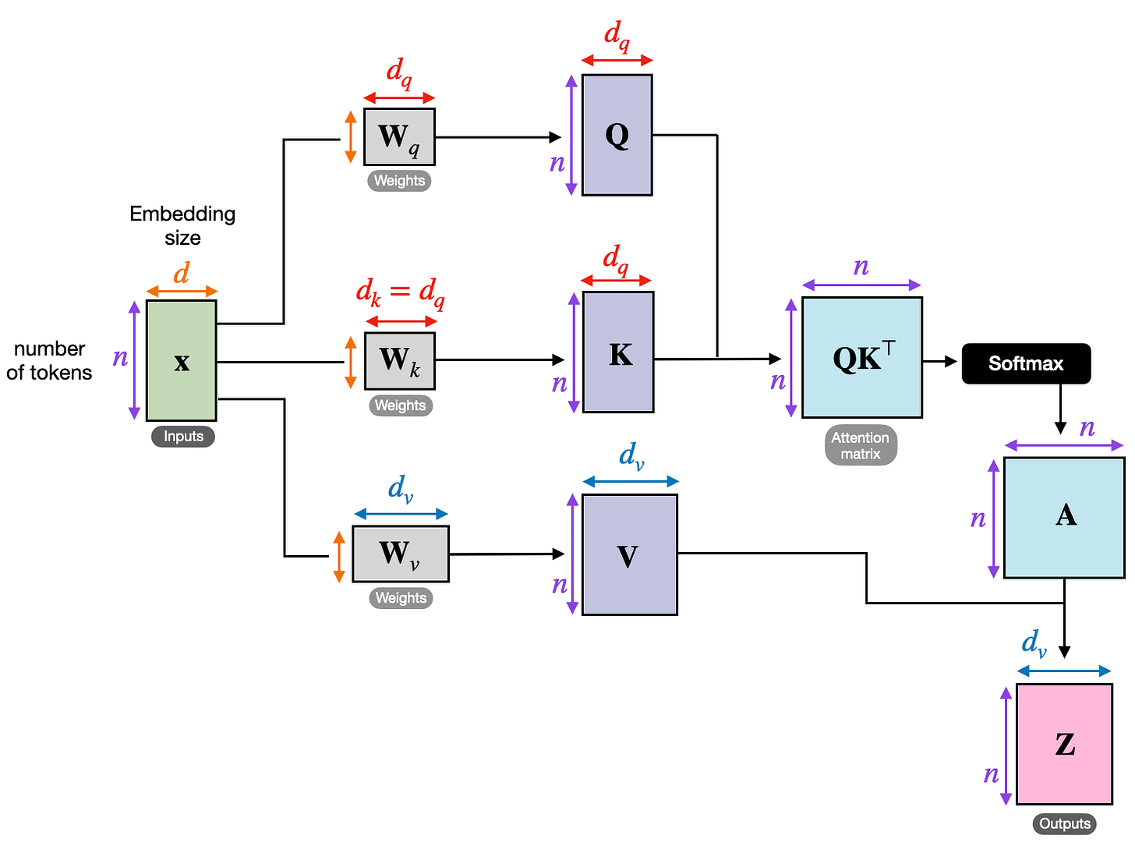
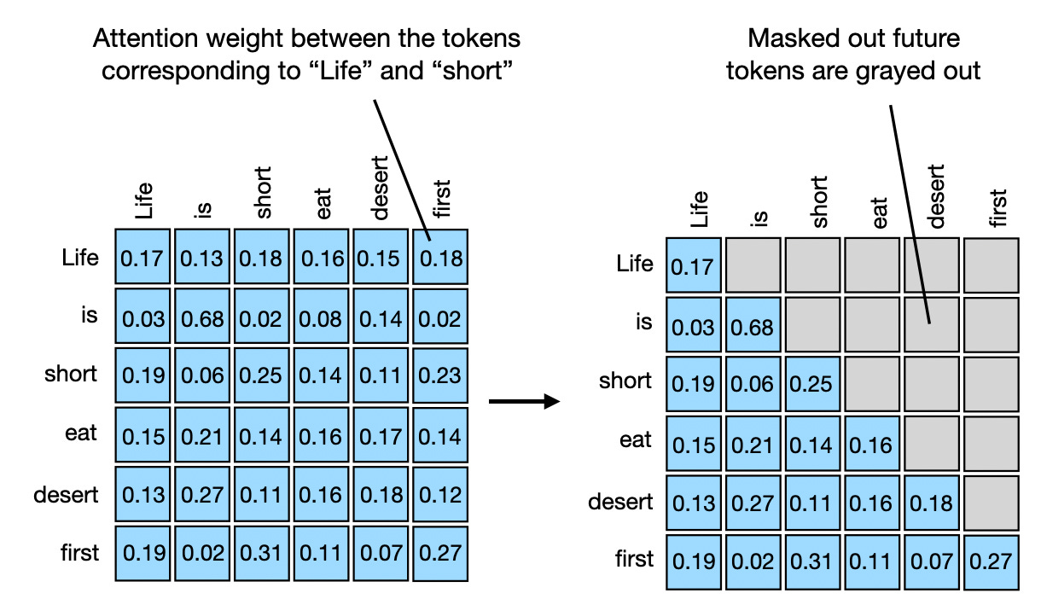
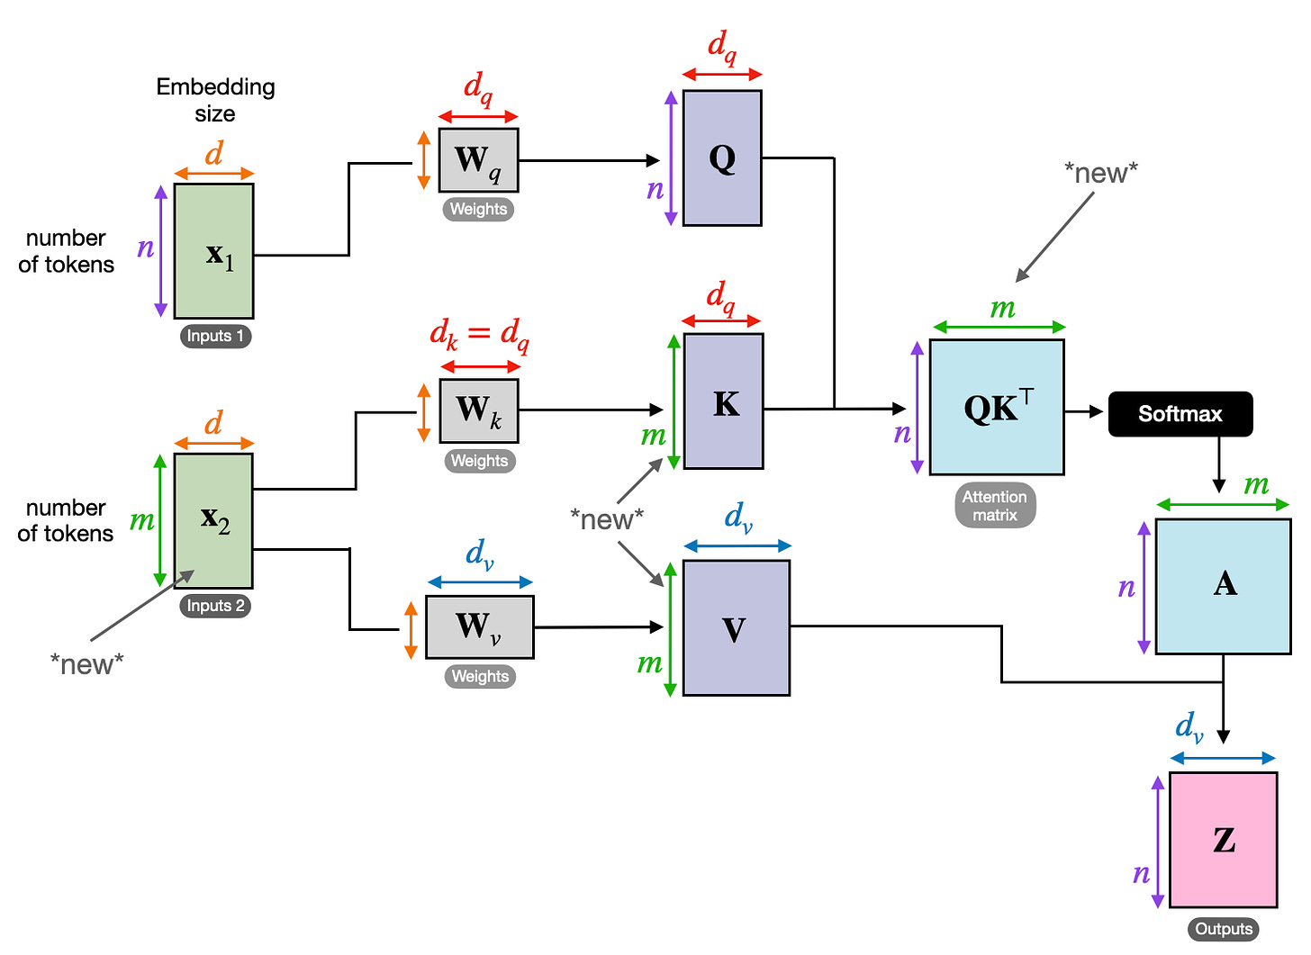
Attention
Self-attention
Causal-attention
Self-attention
Cross-attention

Slide 20
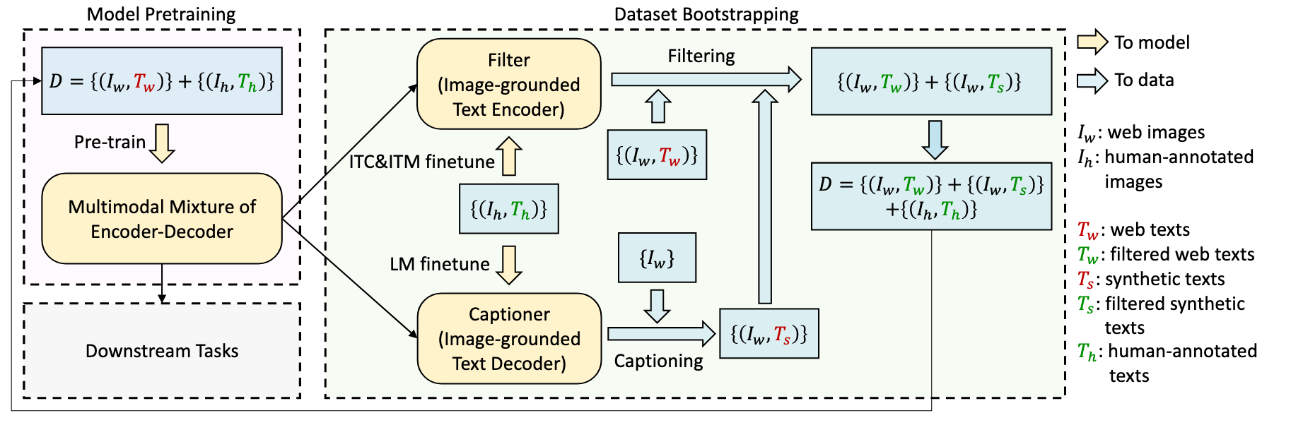
BLIP-Method
Captioning and Filtering (CapFilt) is designed to filter noisy captions in large-scale image-text datasets to improve the quality of training data
BLIP: Bootstrapping Language-Image Pre-training for Unified Vision-Language Understanding and Generation

Slide 21
BLIP2-Motivation
The cost of vision-and-language pre-training has become increasingly prohibitive due to end-to-end training of large-scale models.
BLIP-2: Bootstrapping Language-Image Pre-training with Frozen Image Encoders and Large Language Models

Slide 22
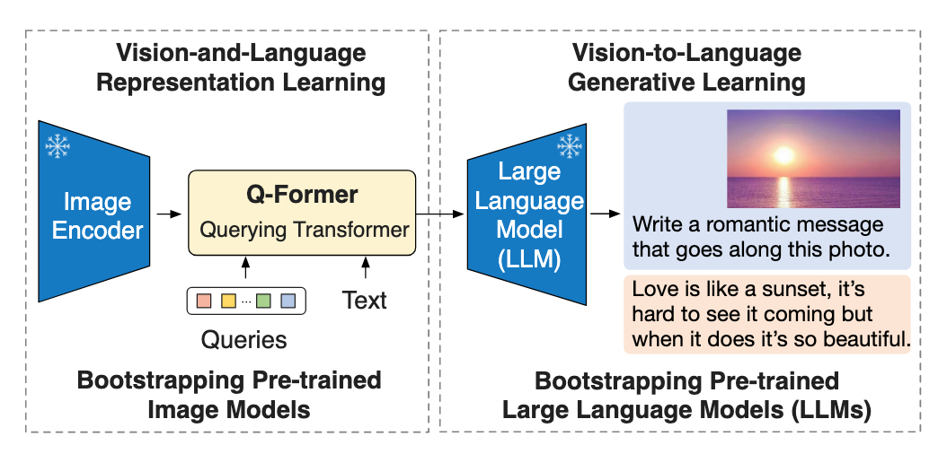
BLIP2-Method
• Representation Learning:
Querying visual information most related to text
• Generation Learning:
Feed the most useful visual feature for LLM as a bottleneck.
BLIP-2: Bootstrapping Language-Image Pre-training with Frozen Image Encoders and Large Language Models

Slide 23
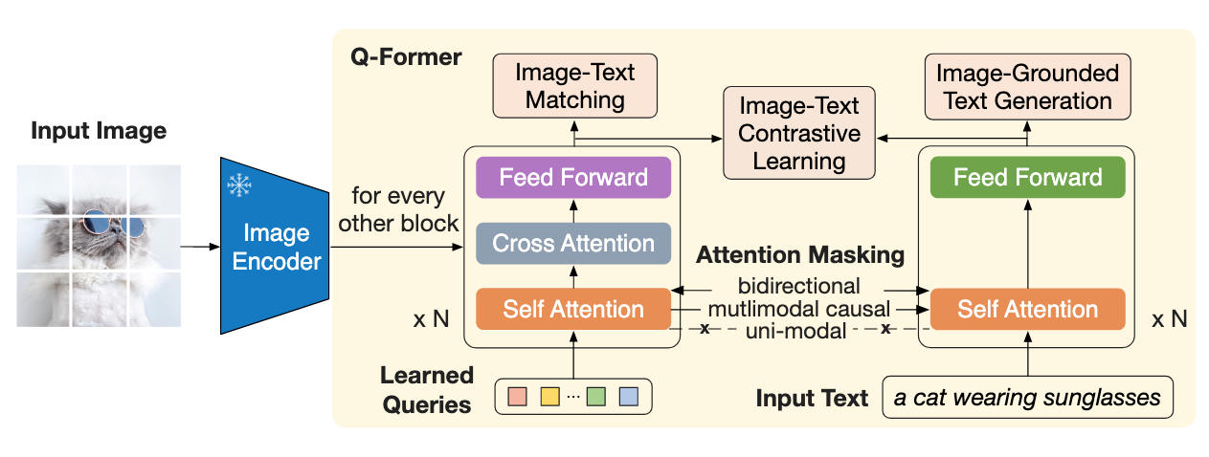
BLIP2-Method
Representation Learning
BLIP-2: Bootstrapping Language-Image Pre-training with Frozen Image Encoders and Large Language Models

Slide 24
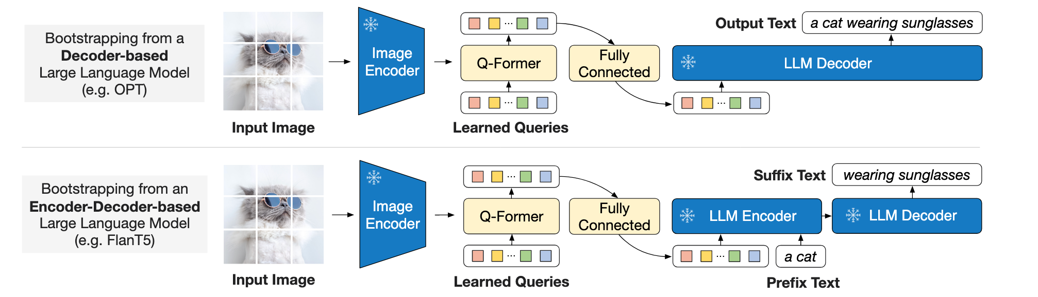
BLIP2-Method
Generation Learning
BLIP-2: Bootstrapping Language-Image Pre-training with Frozen Image Encoders and Large Language Models

